Slide 1
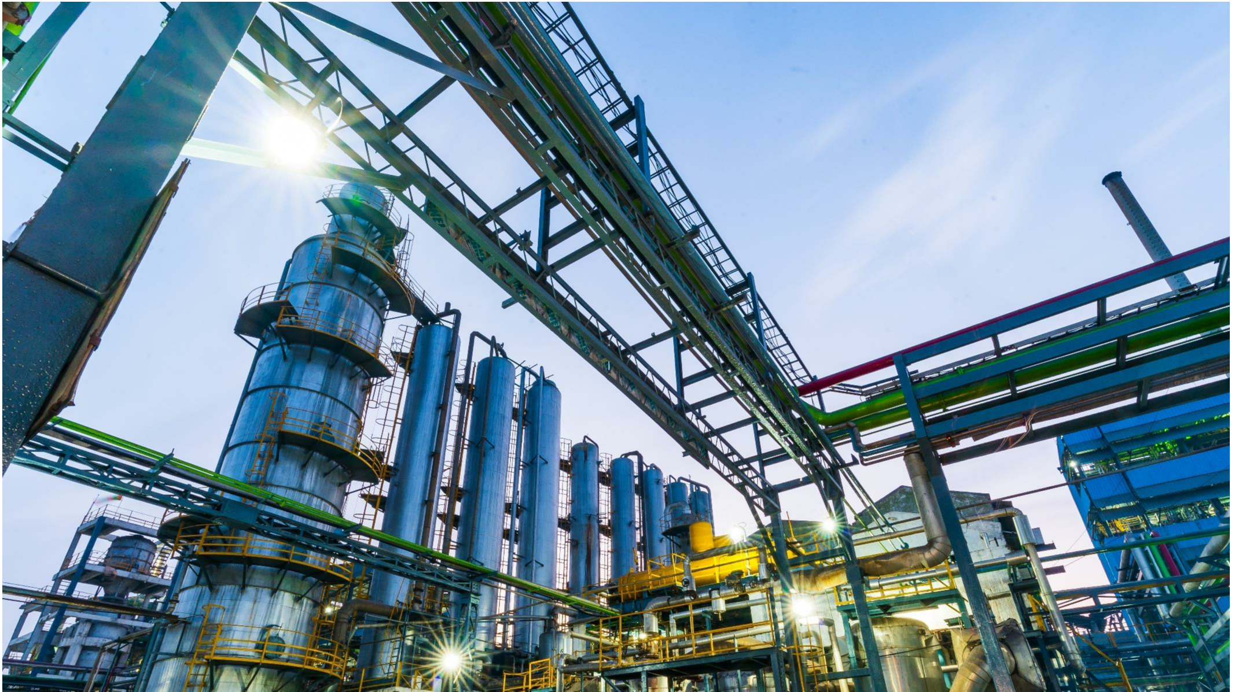
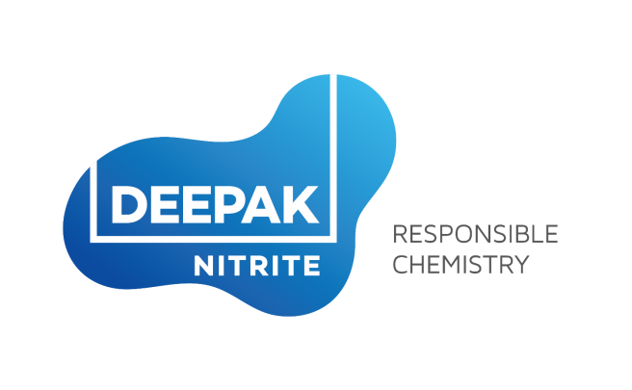
CORPORATE
PRESENTATION
June 2018

Slide 2
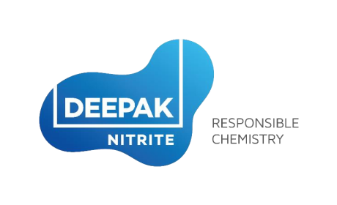
GROUP COMPANIES
ISO 9001, 14001, OHSAS 18001
1

Slide 3
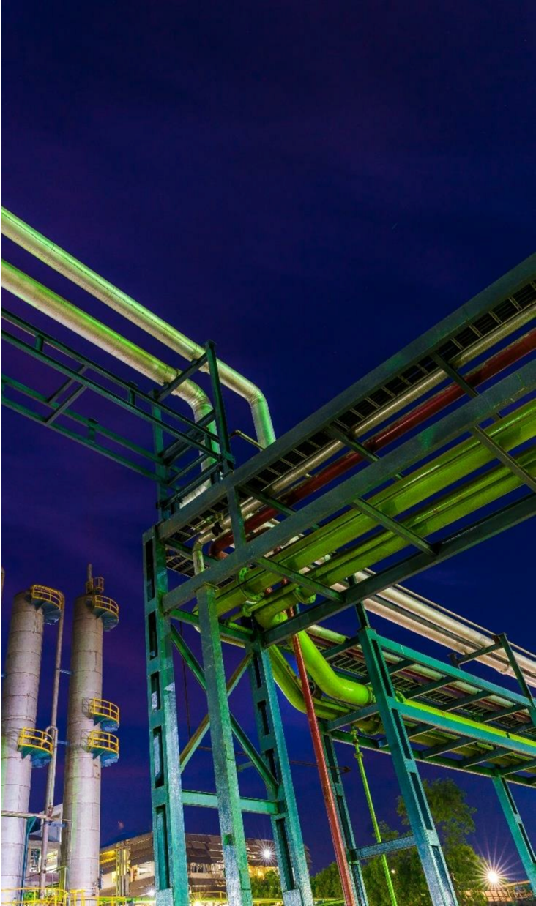
Values:
Innovativeness
Driving not just product ideas but also
innovation in terms of processes and employee
engagement thus maximizing growth.
Responsiveness
Towards, employees, customers and all
other stakeholders.
VISION-
VALUES
Ownership
Where the vision becomes not just the
company goal but the individual goal as well.
Performance driven
Rewarding performers across verticals,
thereby setting examples for leadership.
Vision
Agility
To become the FASTEST GROWING
Indian chemical intermediates company.
Change is constant. This equips the organization
to respond rapidly to this dynamic world.
2

Slide 4
Health & Safety
Environment
Focus on plant, process and
people safety.
Dedicated cell for conservation through improvisation
in processes and products.
Emergency preparedness through drills and
pre-tests.
Effluent treatment plants compliant with
control norms.
pollution
HAZOP studies and safety inspections.
Occupational health centre at each unit.
RESPONSIBLE
CHEMISTRY
Community Care
Community development through
Deepak Foundation
Social interventions spanning over
1,500 villages in Gujarat
Focus areas include:
• Women & Child Welfare
• Integrated Livelihood Promotion
• Disaster Relief
• Rehabilitation & Integrated Child
Development Schemes
3

Slide 5
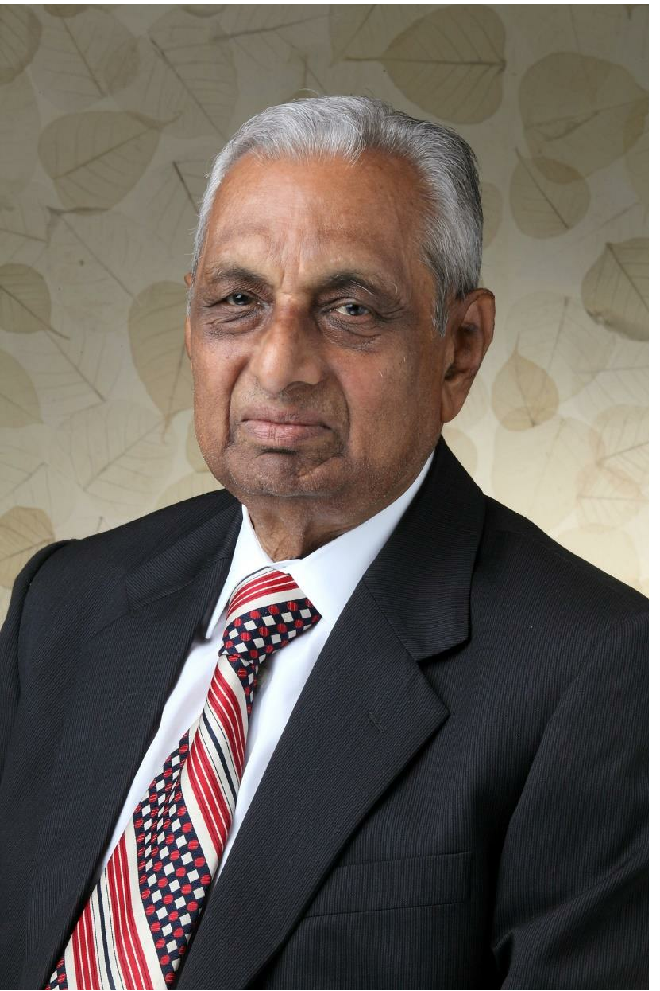
Mr. C.K. Mehta,
Chairman-Emeritus
• A pioneer , visionary and founder with over
five decades of versatile experience in
Chemical.
ABOUT
•
He is credited with leading an able Board
and laying the foundation of a strong
professionally driven organisation at par
excellence.
THE FOUNDER
• Today, he is more like a inspiration of DNL
and all group Cos, including foundation
• Instrumental in initiating company’s CSR
initiatives and in establishing the Deepak
Foundation.
• Recipient of ICC Lifetime Achievement
Award in 2014
4

Slide 6
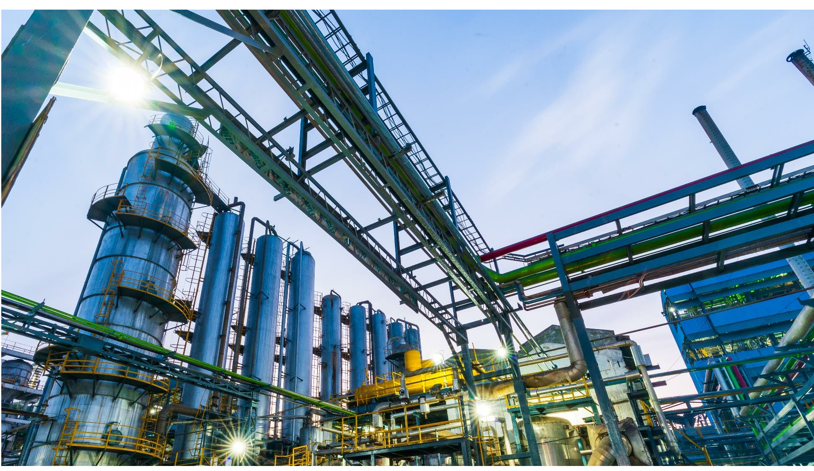
BOARD OF
DIRECTORS &
LEADERSHIP
TEAM
5

Slide 7
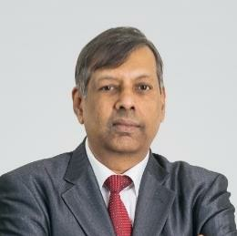
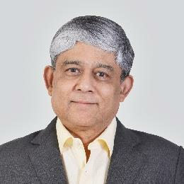
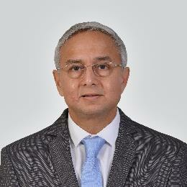
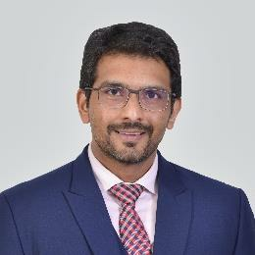
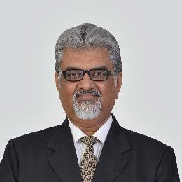
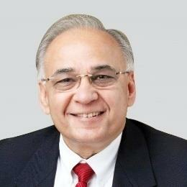
PROFESSIONAL BOARD OF DIRECTORS BACKED BY A
STRONG TEAM
MR. D. C. MEHTA
MR. UMESH ASAIKAR
MR. SANJAY UPADHYAY
Chairman & Managing Director
Executive Director & Chief Executive Officer
Director, Finance & Chief Financial Officer
Mr. D. C. Mehta is a dynamic
personality whose business acumen
has enabled the Company to take
swift strides forward and achieve
new laurels, year after year. He is at
the helm of affairs at Deepak Nitrite
for the last 38 years. He is a Science
Graduate from the University of
Bombay.
Mr. Umesh Asaikar has been associated
with the Company since September 2008.
He has around 37 years of varied
experience in the areas of Sales and
Marketing, Manufacturing, Commercial and
Business Management across industries
including pharmaceuticals, vitamins and
fine chemicals, glass flacconage, etc.
Mr. Sanjay Upadhyay is an associate
member of the Institute of Cost
Accountants of India. He is also a Fellow
of the Institute of Company Secretaries
of India. He has vast experience in the
areas of Finance, Accounts, Commercial
and Secretarial Functions. He is
associated with the Company since 1994.
MR. MAULIK MEHTA
MR. A. C. MEHTA
MR. SUDHIN CHOKSEY
Additional Director & Whole-Time Director
Non Executive Director
Independent Director
Mr. Maulik D. Mehta holds a Bachelors
degree in Business Administration from
University of Liverpool, UK. He has also
done Masters in Industrial and
Organizational Psychology from
Columbia University, USA. He has
around 8 years of experience in
the areas of Business Development.
Mr. A. C. Mehta has been actively
associated with the Company since 1984.
With extensive experience,
a comprehensive approach and strong
industry foresight, he has paved the way for
innovation and excellence in the Company.
Mr. Sudhin Choksey has extensive
experience in handling functional areas
of finance, commerce and general
management, both in India and abroad.
He is the Managing Director of GRUH
Finance Ltd and also a Fellow Member
of the Institute of Chartered
Accountants of India.
6

Slide 8
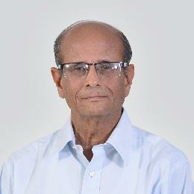
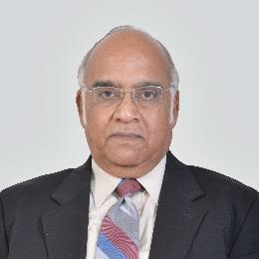
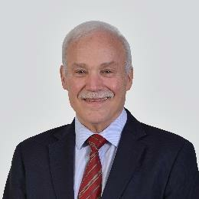
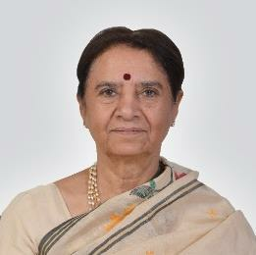
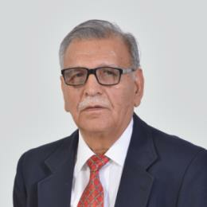
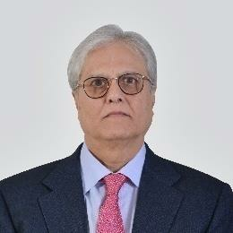
PROFESSIONAL BOARD OF DIRECTORS BACKED BY A
STRONG TEAM
MR. SUDHIR MANKAD
DR. S. SIVARAM
DR. RICHARD H. RUPP
Independent Director
Independent Director
Independent
Director
Dr. Sivaram is a scientist of distinction,
having held leadership positions in R&D,
in both industry and academia. He has
done his M.Sc. from the Indian Institute
of Technology, Kanpur, and Ph.D. from
Purdue University, W. Lafayette, Indiana,
USA.
Dr.
top level
positions in leading multinational
Mr. Sudhir Mankad, IAS (Retd.), has
served in senior positions, both with
the Government of India and the
Government of Gujarat. His last
assignment was Chief Secretary,
Government of Gujarat. He has
served as a Director/Chairman on
the Board of several companies.
Rupp has held various
companies such as Hoechst AG
(Germany), Lonza (Switzerland) and
Allessachemie (Germany). His focus is
in the field of pharmaceuticals and
fine chemicals.
PROF. INDIRA PARIKH
MR.
S. K. ANAND
MR.
NIMESH KAMPANI
Independent Director
Independent
Director
Independent
Director
Prof. Indira Parikh is the Founder
President of FLAME (Foundation for
Liberal and Management Education).
She holds a Ph.D. from the Gujarat
University and MA from University of
Rochester. She was a faculty member
at IIM-A, for over 30 years and the
Dean from 2002 to 2005
Mr. S. K. Anand has a rich experience
of around 44 years in the field of
Project Management, Operations,
Corporate Planning, Quality
Management, Health, Safety and
Environment Management, Energy
Management and Strategic Planning
in petrochemicals, refining and other
allied industries.
Mr.
Nimesh
Kampani
is the
Founder and Chairman of the JM
Financial Group, one of India’s
leading financial services group. In
a career spanning four decades,
he has made invaluable
contributions to the development
of Indian capital market.
7

Slide 9
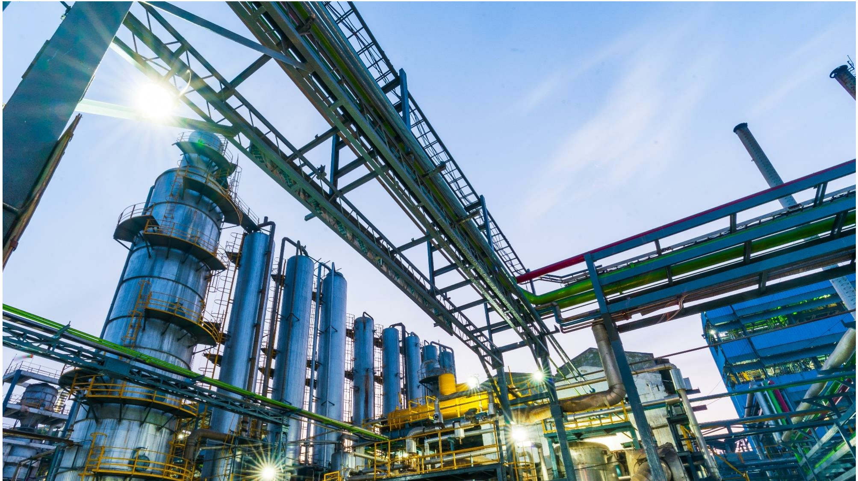
HISTORY
1970
1971
1972
1984
1992
1995
2003
2007
2010
Incorporation
of Deepak
Nitrite Limited
Listed on BSE
with landmark
over-subscription
Commissioned
Sodium Nitrite &
Sodium Nitrate
Plant at Vadodara,
Gujarat
Acquisition of
Sahyadri Dyestuffs
& Chemicals unit
from Mafatlal
Industries
Commissioned
Nitro Aromatic
Plant at Nandesari
Commissioned a
full fledged
Hydrogenation
Plant at Taloja
Acquisition of
management and
control of Aryan
Pesticides Limited
Acquisition of
DASDA Division
from Vasant
Chemicals at
Telangana
Foray into Fuel
Additives business
2012
2013
2014
2015
2016
2017
2018
Accredited with
‘Responsible Care' –
a global benchmark of
environment, safety and
health management
Brownfield expansion
for manufacturing
Sodium Nitrite &
Sodium Nitrate at
Nandesari
Commissioned a
world-class facility to
manufacture Optical
Brightening Agents
(OBA)
Promoted Deepak
Phenolics Limited for
manufacturing of
Phenol & Acetone
Raised INR 83 crore
via QIP (1st Round)
to fund the phenol
project
Raised INR 150 crore
via QIP (2nd Round)
to fund the phenol
project
Deepak Phenolics
Limited commissioned.
Production starts
Turnover crosses
INR 1,000 crore
milestone
8

Slide 10
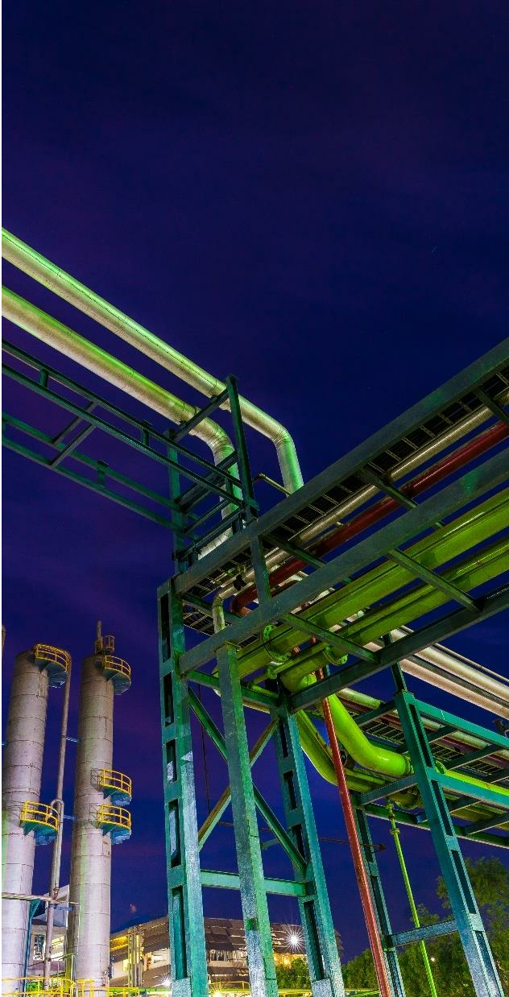
Net
Leading
producer
1600
+
Revenue
1455 Cr.
Employees
of Sodium Nitrite
and Sodium Nitrate
since 1972
COMPANY
FY17-18
OVERVIEW
Amongst top
3 global
players
5
Exports
Since 1972, Deepak Nitrite has been
a leading intermediates company in
the Indian chemical industry.
We serve numerous industries & 56
applications with a portfolio of
over 100 international quality
products.
We are a recognized globally as a
‘Responsible Manufacturer’ and as a
Manufacturing
locations
to 30 countries,
6 continents
for products like
Xylidines, Cumidines
and Oximes
‘Supplier of Choice’ by our clients.
1000+
50 years
Customers
Legacy
par excellence
9

Slide 11
30
6
56+
Countries
Continents
Applications
GLOBAL REACH
1000+
100+
Customers
Products
10

Slide 12
Large product portfolio
of value-added
intermediates
Among top 3 global
players in Xylidines,
Cumidines and Oximes
VALUE
Exports to
30 countries
and growing
Balanced
PROPOSITION
import-export revenues
Largest
Phenol-Acetone plant
in India for increasing
demand
11

Slide 13
Product Portfolio:
Applications
Basic Chemicals
Fine & Specialty Chemicals
Performance Products
Pharmaceuticals
Agrochemicals
Supplier of Choice for :
MAJOR
CUSTOMERS
Personal Care
Petrochemicals
Dyes and Pigments
Paper
Fuel Additives
Detergents
12

Slide 14
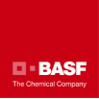
CLIENTS
13

Slide 15
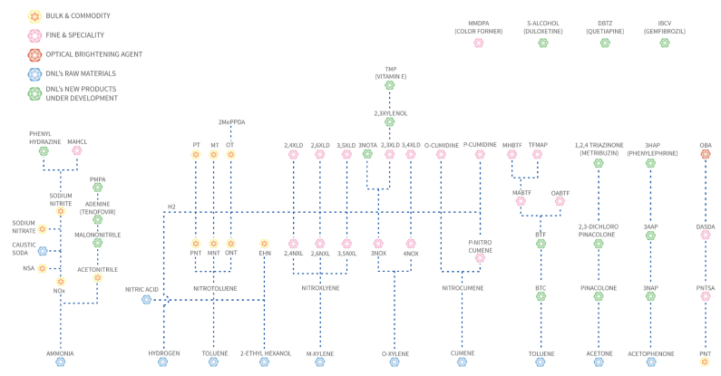
CHEMISTRY OF GROWTH
14

Slide 16
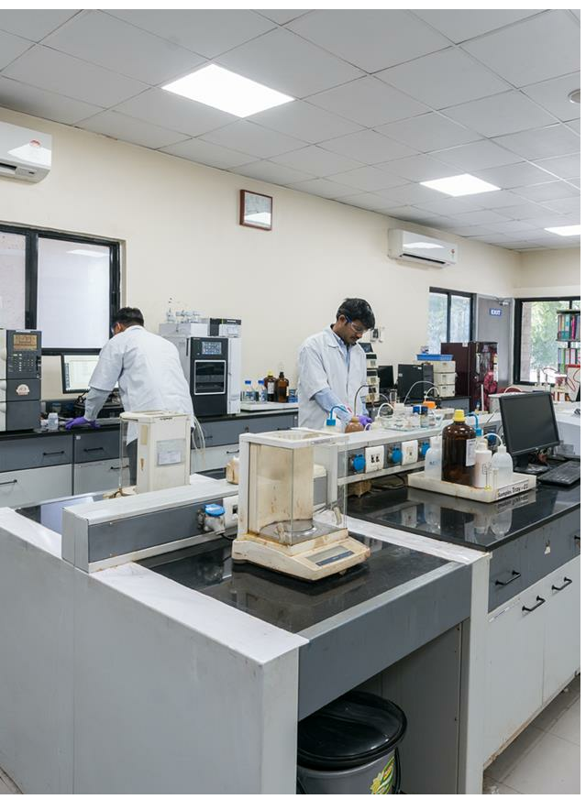
ISO 9001, 14001, OHSAS 18001
Dedicated
centralised
facility At
Recognized by
Strong team of
Department of
45+
Scientific &
Industrial
Nandesari,
Gujarat, India
Scientists
Government recognized
Research
Govt. of India
Strong team of 45 scientists
8 patents Granted
8 patents applied
Patented chemistries developed and commercialized for
global consumption
Cost-effective and eco-friendly process development
Chemical synthesis for different product segments
DEEPAK R&D
Advanced Intermediate developed & commercialized
For MNCs
CENTRE
Fields of Expertise:
Advanced Sulphonation
Multiple Pathway Oxidation
Continuous Reduction Nanotechnology
Ion-exchange Resins
Location: Nandesari, Gujarat, India
Facilities
State-of-the-art
Expertise in multiple chemical processes
Instruments and Equipment
• HPLCs and GCs
• FTIR
• UV-visible spectrophotometer
• Micro reactor
• Wiped film evaporator
• Vapour phase fixed bed reactors
• Autoclaves of various capacities and MOCs
• Horizontal beadmill
• Rotary furnace
• Multiple CSTR assembly
• Nanofiltration setup
Nitration I Catalytic hydrogenation I Sulphonation
Oxidation I Oxidative Coupling I Alkylayion ( C, N & O)
Dissolving metal Reduction I Diazotization I Lithiation
Ammonidation I Halogenation I C-C ( Grignard, Suzuki, Heck etc)
Enzyme catalysis
15

Slide 17
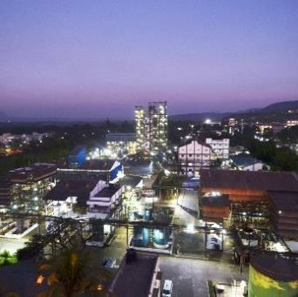
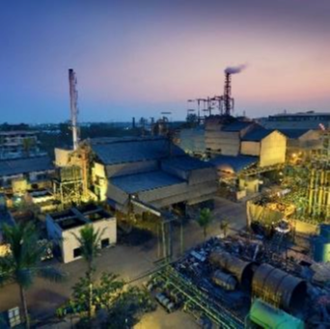
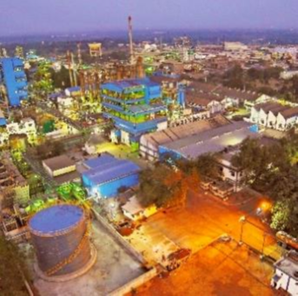
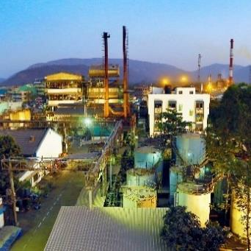
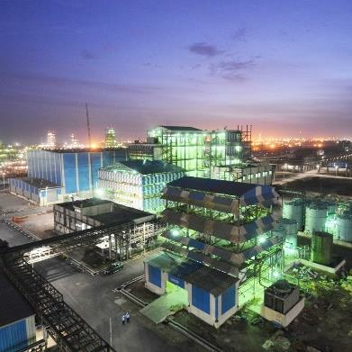
MANUFACTURING FACILITIES
Nandesari
Taloja
Dahej
The first and flagship
manufacturing facility.
Synthetic Organic
chemicals, Fine and
Specialty chemicals
Basic chemicals, Fine and
Specialty chemicals and
Performance products.
Basic chemicals,
Bulk chemical commodity
Fully automatic batch
process with production
capacity of 100 thousand
tonnes.
Roha
Hyderabad
Intermediates for
Agrochemicals, Dyes,
Fine and Specialty
chemicals.
DASDA
20% of world's market
share of DASDA
business.
16

Slide 18
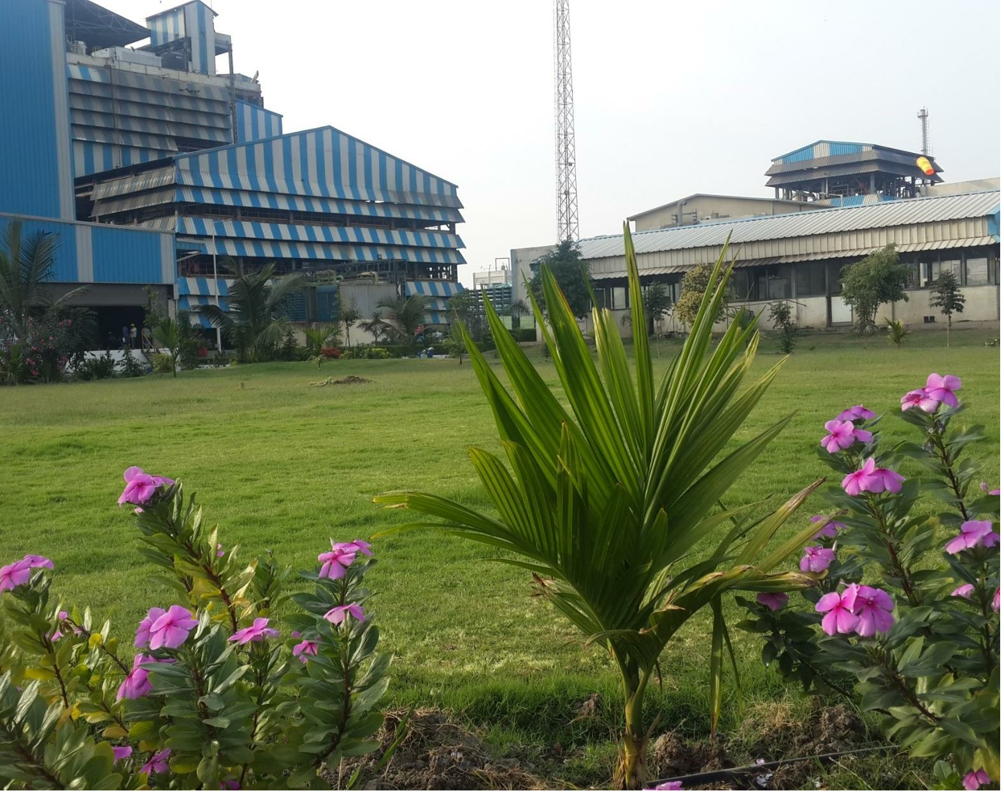
Green Belt
21000 Sq. Mt
ECO-CONSCIOUS
17

Slide 19
• Nitro Toluenes
• Sodium Nitrite / Nitrate
• Fuel Additives
BUSINESS
Colourants
Petrochemicals
Rubber
SEGMENTS
50%
▪ High volume segment consisting - Bulk
Chemicals & Commodities made to standard
specifications.
BASIC CHEMICALS
(BCC)
Total Revenues in FY17
▪ Manufacturing both organic & inorganic
chemicals.
▪ Classified under organic chemicals – Nitro
Toluene, Ortho Toluene, EHN and Inorganic
Chemicals - Sodium Nitrites & Sodium
Nitrates
50%
18

Slide 20
• Xylidines
• Oximes
• Cumidines
• Specialty Agrochemicals
Pharmaceuticals
Paper
Agrochemicals
BUSINESS
SEGMENTS
30%
• Includes niche products that require greater
value addition.
FINE AND SPECIALTY
CHEMICALS
Total Revenues in FY17
• Segregated into Specialty Chemicals,
Xylidines, Oximes, Cumidines, Nitro Xylene
amongst others.
• Products customized as per customer
specifications.
30%
• Application in the manufacture of agrochemicals,
pharmaceuticals, pigments, paper, hair colours etc.
19

Slide 21
Optical Brightening Agent
(OBA)
BUSINESS
20%
SEGMENTS
Total Revenues in FY17
PERFORMANCE
PRODUCTS
20%
• FWA is an application chemical; commonly
known as Optical Brightening Agent (OBA).
• Fully integrated manufacturer of FWA.
• Wide applications across Paper, Detergents,
Textiles, Coating Applications in Printing &
Photographic Paper
• Customised into liquid or powdered form, as
per the customer’s requirements.
20

Slide 22
International
Domestic
OBA
CUSTOMERS
21

Slide 23
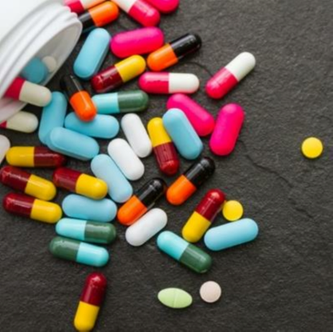
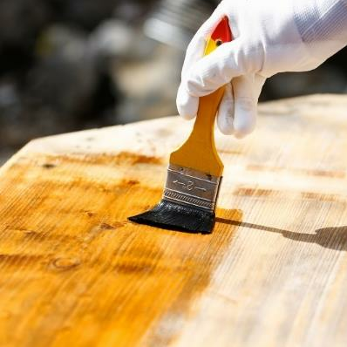
NEW
LAUNCHES
Agrochemicals
Pharmaceuticals
Wood preservatives
1,2,4 Triazinone
Adenine
(With pesticide content)
(CAS NO. 33509-43-2)
(CAS NO. 73-24-5)
Protecto B plus premium
3-Amino Benzotrifluoride
3-HAP
Protecto GLP plus
(CAS NO.98-16-8)
(CAS NO. 121-71-1)
2-Amino Benzotrifluoride
Protecto PFB plus
(CAS NO. 88-17-5)
3-Hydroxy Benzotrifluoride
(CAS NO. 98-17-9)
22

Slide 24
NEW
LAUNCHES
Agrochemicals
Pharmaceuticals
Wood preservatives
1,2,4 Triazinone
Adenine
(With pesticide content)
(CAS NO. 33509-43-2)
(CAS NO. 73-24-5)
Protecto B plus premium
3-Amino Benzotrifluoride
3-HAP
Protecto GLP plus
(CAS NO.98-16-8)
(CAS NO. 121-71-1)
2-Amino Benzotrifluoride
Protecto PFB plus
(CAS NO. 88-17-5)
3-Hydroxy Benzotrifluoride
(CAS NO. 98-17-9)
22

Slide 25
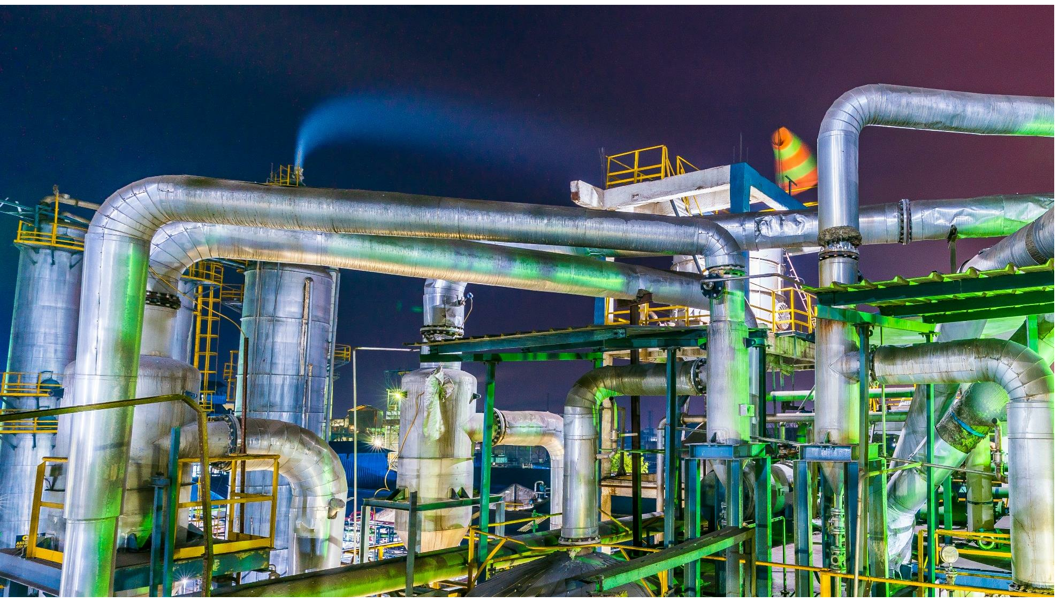
PHENOL
PROJECT
23

Slide 26
MARKET OPPORTUNITY
Dahej Facility
Phenol Demand - 2014
250,100 MT
Estimated Demand for Phenol in 2017-18
3 20,000 MT
Imports
HOC
16%
13%
SI Group
Phenol
Demand Supply
in India
4%
12%
DNL’s facility
(200,000MT) will
start operations in 2017 -18
The total is coming to 102
12%
63%
80%
The plant at Dahej will help
substitute the imports and give
DNL a market leadership position
for phenol & acetone in India
Acetone Demand - 2014
156,734 MT
Estimated Demand for Acetone in 2017-18
3 20,000 MT
15%
5%
12%
Acetone
Demand Supply
in India
12%
DNL’s facility
(200,000MT) will
start operations in 2017 -18
16%
60%
80%
Source: CRISIL
24

Slide 27
Manufacturing Capacity
200 KTPA
120 KTPA
Total manufacturing capacity for Phenol
PHENOL &
Total manufacturing capacity for Acetone
260 KTPA
ACETONE
Total manufacturing capacity for Cumene
FACILITY AT
DAHEJ -
SNAPSHOT
Technology Tie-ups
• Technology tie-up with KBR (USA) & UOP Honeywell
• KBR is a licensor of phenol capacity
25

Slide 28
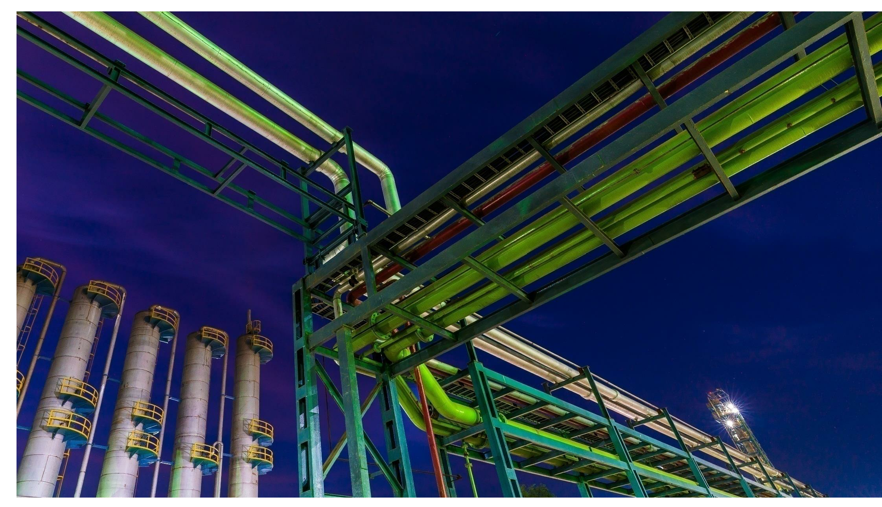
FINANCIALS
26

Slide 29
Financial Summary
Market Capitalisation (in Rs. Cr)
1455
Net Revenue
FINANCIAL
3381
214
SUMMARY
EBITDA
146
2018
2010
84
*PAT
*Normalized PAT
27

Slide 30
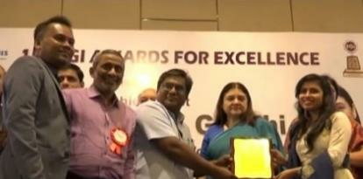
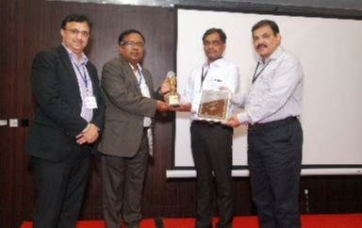
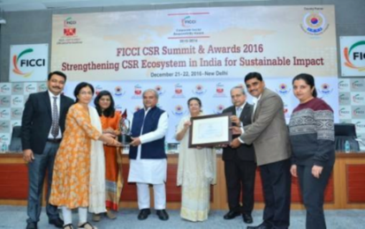
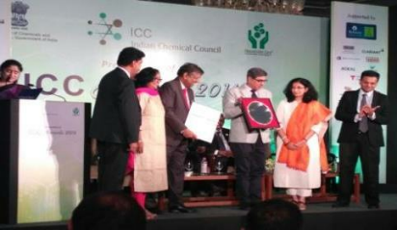
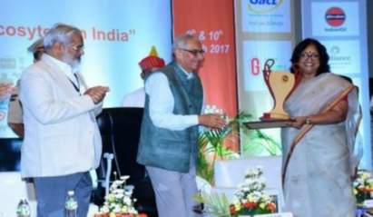
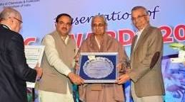
FGI award, 2018
Certificate of Merit
Excellent Performance as
Most Collaborative Partner,
2017
FICCI CSR Award, 2016
Deepak Foundation was conferred with a
Certificate of Merit at the 15th Federation of
Gujarat Industries (FGI) awards.
Deepak Nitrite Limited, as the parent company
of Deepak Foundation, received the FICCI CSR
Awards 2015-16.
Deepak Nitrite recognised by Rallis, A
TATA Group Company.
AWARDS
ICC Award For Social
Responsibility, 2017
GCSRA Awards, 2017
ICC Lifetime Achievement
Award, 2014
Comprehensive Emergency Obstetric and
Newborn Care (CEmONC) unit at Jabugam
The
Mr.
C.K. Mehta, Chairman, Deepak Group of Industries
Deepak Foundation conferred with the
ICC Award For Social Responsibility by
the Indian Chemical Council.
received the best CSR project for Cohesive &
Strategic Partnerships under the large
companies’ category.
Indian
Chemical
Council
(ICC)
conferred
with the ICC lifetime achievement award.
28

Slide 31
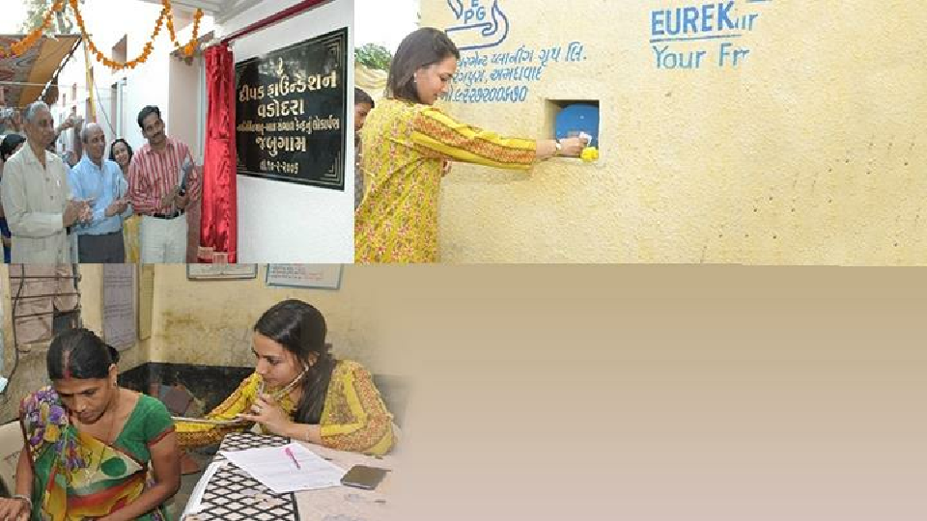
CORPORATE
SOCIAL
RESPONSIBILITY
29

Slide 32
40+ years I 2 million people
- Maternal & neonatal care
- Livelihood projects
Some of the key initiatives include:
DEEPAK
EDUCATION:
MEDICAL INITIATIVES:
FOUNDATION
Integrated child development services
Occupational health services in GIDC
Mobile library
Quality care in tribal areas
Wage employment trainings
Healthcare at doorstep
Medical intervention & services
De-addiction & counselling services
LIVELIHOOD
Blood donation camp
Water harvesting
30

Slide 33
CONTACT
Aaditya - I, Chhani Road, Vadodara - 390024. Gujarat, India.
INFORMATION
Tel: +91 265 276 5200/396 0200 | Fax: +91 265 276 5344
www.deepaknitrite.com
Email ID: investors@deepaknitrite.com
31

